Slide 1

Provider Orientation Training

Slide 2

SummaCare
Health Insurance Company Established 1993
Local, Provider Owned
Four Product Lines
Total Membership – 65,000+
31 County Northern Ohio
Service Area
15,000+ Providers, 70+ Hospitals
350+ Employees

Slide 3

Apex Health Solutions
In 2001, Apex Health Solutions was created. Headquartered with SummaCare in Akron, Ohio, Apex Health Solutions provides benefit administration for self-funded employers.
Today, SummaCare and Apex Health Solutions, both wholly-owned subsidiaries of Summa Insurance Company, provide services to meet the needs of clients and employers, both fully-insured in Ohio and self-funded locally (i.e., Summa Health, Goodyear).

Slide 4
Service Area

Slide 5
SummaCare Service Area
Lucas
Lake
Ashtabula
Williams
Fulton
Ottawa
Geauga
Sandusky
Erie
Lorain
Cuyahoga
Trumbull
Defiance
Henry
Wood
Paulding
Seneca
Huron
Medina
Summit
Portage
Putnam
Hancock
Mahoning
Van Wert
Wyandot
Crawford
Ashland
Wayne
Stark
Columbiana
Key
Allen
Richland
Marketplace (Individual & Family)
Employer (Commercial Group) *included in MEWA service area
Medicare Advantage
Hardin
Marion
Holmes
Carroll
Mercer
Auglaize
Morrow
Knox
Tuscarawas
Jefferson
Shelby
Logan
Union
Delaware
Coshocton
Harrison
Darke
Miami
Champaign
Licking
Guernsey
Belmont
Clark
Franklin
Muskingum
Preble
Madison
Noble
Monroe
Montgomery
Greene
Pickaway
Fairfield
Perry
Morgan
Fayette
Hocking
Washington
Butler
Warren
Clinton
Ross
Athens
Hamilton
Highland
Vinton
Clermont
Pike
Jackson
Meigs
Brown
Adams
Scioto
Gallia
Lawrence

Slide 6
Product Lines

Slide 7
Product Lines
Medicare (65+) More info click here: Summacare Medicare
Individual
Group Retirees
Group Fully-Insured More info click here: Employer Groups
Small Group off SHOP (Small Business Health Options Program)
Large Group
Individual & Family (Pre-65) More info click here: Individual Plans
On and off Marketplace
Self-Funded More info click here: Self-Funded Plans
Large Group
MEWA – small group plans through local chamber of commerce

Slide 8
SummaCare Networks
As a contracted SummaCare provider, your practice may not participate in every network. Please check your contract to confirm network participation, or confirm each physician’s participation by using our online Provider Search located on our website at www.summacare.com.
SCMedicare
SCPremier
SCSelect
SCConnect
Mercy Choice
Preferred Choice
NewHealthConnect Summa Health (Summa Health Employee Health Plan)
NewHealthConnect Summa Home Health (Summa Home Health and Hospice Employee Health Plan)
NewHealthConnect Pioneer (Pioneer Physician Network Employee Health Plan)

Slide 9
Health Services Management

Slide 10
Approval is based on plan benefits and medical necessity. Prior authorization requests must be submitted 48 hours prior to the service being rendered. Failure to request approval will result in a denial with no member liability. Requests may be submitted online at Plan Central or via Fax. Online: Plan Central Access Fax documents and contact numbers: Prior-Authorization-Services
Prior Authorization Requests

Slide 11
Prior Authorization Requests
Fax Transmission
Inpatient: 234.542.0811
Hi Tech Radiology, Genomic Testing, Medical and Radiation Oncology: 800.540.2406 (managed by Evicore)
All Other Requests: 234.542.0815
Urgent requests only, please call 330.996.8710.
Utilize Plan Central to check the status of a prior authorization.

Slide 12

HOMELINK Prior Authorizations
Transportation (administered through HOMELINK)
$0 copay
Number of one-way trips ranges from 4 to 12 (Medicare only)
Home Safety Devices (administered through HOMELINK)
$150 to $250 annual allowance (Medicare only)
Hearing (administered through HOMELINK)
$795 copay per hearing aids. Coverage for one hearing aid per ear every year. (Medicare only)
Durable Medical Equipment (all product lines)

Slide 13
HOMELINK Customer Service
HOMELINK Customer Service has a dedicated SummaCare/Apex Team that is available 24 hours a day, 7 days a week.
Phone: 844.358.2549
Fax: 844.582.3858
homelinksummacare@vgm.com

Slide 14
Member Programs
Condition Management
Registered nurses provide education and resources to help manage chronic conditions.
Conditions: Asthma, COPD, diabetes, depression, A-fib, CHF, HTN, CAD, and CKD.
Quarterly mailings for Asthma, CHF, Diabetes and Depression to provide education and encourage self-management.
Case Management
Members living with a serious illness, or have a high-risk pregnancy, can have a SummaCare registered nurse provide valuable tools and guidance that will help them feel their best.
Health Coaching
A health coach will help identify at-risk behaviors, help create goals, offer advice, and provide support and guidance, evaluate biometric results and determine risk factors.
Assess nutrition, weight loss, and physical activity habits and barriers.
A member can enroll by calling 877.888.1164

Slide 15
Member Programs
Telehealth services through Teladoc®
Teladoc gives our members access 24 hours a day, seven days a week to a U.S. board-certified doctor who can diagnose many health issues including general medical, behavioral health and dermatology. To create an account, call 800.TELADOC (TTY 711), download the app or visit teladoc.com. (May result in a copay.)
SummaCare 24-Hour Nurse Line
Connect with a registered nurse anytime – day or night by calling 800.379.5001 (TTY 800.750.0750). Get answers to specific medical questions. Get advice on where to seek treatment. Get treatment advice for minor illnesses or injuries. And get a nurse’s opinion on your self-care options at no cost.

Slide 16
Member Programs
QuitCare Smoking Cessation Program
Partnered with National Jewish Health to offer telephonic coaching with a smoking cessation specialist along with up to 8 weeks of nicotine replacement therapy at no cost to the member.
Call 877.471.2101 (TTY 888.229.2182) to enroll.
Health Manager Powered by WebMD®
Get exclusive access to WebMD’s Health Manager online tool. Set personal goals, monitor your health progress, track results, and set personal health and wellness reminders. It’s like having a personal health coach working with you 24/7. To access the Health Manager tool, log into your Plan Central account at summacare.com/plancentral.
Clinical Campaigns
Preventive health reminders and education on the importance of preventive care.
Flu vaccines, mammograms, colorectal screenings, cervical cancer screenings, etc.

Slide 17
Member Programs
SilverSneakers® Fitness Program
Medicare members receive a free fitness membership benefit with access to basic amenities, group exercise classes and online resources, including exercise videos. SilverSneakers also offers FLEX™, which brings fitness classes to convenient locations including retirement communities and recreation centers. For more information, members should visit silversneakers.com or call 888.423.4632 (TTY 711), Monday through Friday, 8 a.m. to 8 p.m. EST.
GlobalFit
SummaCare has partnered with GlobalFit to offer discounted gym memberships, vitamins/supplements, weight loss programs, fitness on demand, and more. It’s free to register at globalfit.com/summacare.
Vision Discounts
Receive discounts on comprehensive eye exams, frames and lenses at participating locations through a discount program called EyeMed Vision Care. Call 866.723.0391 (TTY 711) to learn more.

Slide 18
Member Rights & Responsibilities
Member Rights & Responsibilities Please read the SummaCare Members Rights and Responsibilities carefully. These statements help ensure that members are treated by SummaCare employees and all of our contracted providers with fairness and respect. Likewise, it is important that individuals understand their responsibilities as a SummaCare member. If members do not follow these responsibilities, they may not receive all of the services or coverage to which they might otherwise be entitled. View Member Rights & Responsibilities.

Slide 19
Pharmacy Management

Slide 20
Pharmacy Management
SummaCare's Prescription Drug Benefit incorporates utilization management programs that apply restrictions on certain drugs including Prior Authorization, Step Therapy and Quantity Limits.
Formulary
Tiered Benefit Design
Quarterly Updates
Utilization Management requirements noted per drug
For Prior Authorization
330.996.8400 or toll-free 800.996.8401
Lists of Drugs and Prior Authorization Forms are available on our website at summacare.com
SummaCare’s Pharmacy Benefit Manager (PBM) is MedImpact

Slide 21
Pharmacy Management
Some specialty medications are covered under the medical benefit, while others are covered under the pharmacy benefit. How they are billed dictates where they can be filled.
Pharmacy Benefit
Meds covered under the pharmacy benefit must be filled by Acaria Health for all Commercial members.
Summa Heath System and Community Health Care Employees must use Summa Health Specialty Pharmacy.
Medicare members may use a network specialty pharmacy of their choosing.
Medical Benefit Drugs
Any injectable specialty drug billed under the medical benefit must be filled through Walgreens Specialty. Any specialty drug for IV infusion must be obtained from an in-network Home Infusion Provider.
Home Infusion
Our specialty home infusion providers are OptionCare and Summa Health Home Infusion.

Slide 22
Pharmacy Management
Acaria Health Specialty Pharmacy (commercial members – except as noted below)
phone: 833.626.8417
fax: 833.620.2725
Medicare members are not limited to a particular Specialty Pharmacy
Summa Health Specialty Pharmacy (Summa Health and Community Health Care employees only)
phone: 330.915.2362 or 888.874.8134
fax: 330.375.4262
OptionCare Summa Home Infusion
phone: 844.624.4584 phone: 330-376-1325
fax: 888.314.9062 fax: 330-374-0195
Walgreen’s Specialty Pharmacy
phone: 888.282.5166
fax: 888.570.4700

Slide 23
Claims, Disputes & Appeals

Slide 24
Claim Submission
Claim Submission – EDI Payor ID#s
SummaCare: Medicare, Fully Insured Plans – 95202
Apex Health Solutions: Self-funded – 34196
Adopt electronic remittance and payment to reduce the amount of paper received in your office and to automate payment posting. As always, paper EOPs and checks can be obtained through Plan Central.

Slide 25
Claim Submission
EDI Submission
Click on EDI registration link under Provider Resources on summacare.com:
Electronic Fund Transfer Form
835 Registration Form
TPA Agreement
FTP Registration Form
Plan Central: Click on Updates > Claim Entry
Questions or issues regarding EFT or ERA
EDI helpline edisupport@summacare.com

Slide 26
Overpayment Recovery – Takebacks
A takeback occurs when a claim is overpaid. As an alternative to SummaCare sending an overpayment letter, the amount overpaid is deducted from future payments.
Eliminates paperwork in your office.
Negative balance report carries data from one EOP to the next.
More efficient and easy to keep track of what is due.
Future payments to your office will be reduced until the negative balance has been eliminated.
If balance exists after 60 days, a refund letter will be sent.
If refund is not received within 30 days of the request, the negative balance will be forwarded to a collection agency.

Slide 27
Overpayment Recovery – Takebacks
If you would like to initiate the process, please send a request on your office letterhead to the following address or fax number:
Recovery Dept., c/o SummaCare, Inc.,
1200 East Market Street, Suite 400
Akron, Ohio 44305
Fax: 330.996.8490
Questions:
contactproviderservices@summacare.com
800.996.8401 or 330.996.8400
*Providers may be subject to audits from outside sources.

Slide 28
Payment Disputes
Providers have 60 days from the date of the EOP to dispute a claim. (code edit denials, pricing issue)
Disputes can be submitted in Plan Central: click on the claim in question and then the adjustment request tab.
If the claim is processed correctly, a response will be submitted back to the requestor through Plan Central.
If the claim was processed incorrectly it will be forwarded for reprocessing.

Slide 29
Appeals & Grievances

Slide 30

Appeal Turnaround Times
Commercial Fully Insured:
Expedited Pre-Service: 48 hours
Standard Pre-Service: 10 days
Post-Service: 30 days
Medicare:
Expedited Pre-Service: 72 hours
Standard Pre-Service: 30 days
Post-Service: 60 days
Self-Funded:
Expedited: 72 hours
Standard Pre-Service: 15 days
Post-Service: 30 days

Slide 31
Suggested Best Practices for Appeals
Do NOT EXPEDITE a case if it is not medically necessary
SummaCare must respond with a decision prior to the expiration of timeframe.
FRIDAY Appeal Cases
SummaCare must respond with a decision prior to the expiration of timeframe.
If the case is missing any form of documentation that requires SummaCare to reach out and the offices are closed then we must respond based on the information we have on hand.

Slide 32
Member Grievances
SummaCare must respond to all member complaints (grievances) within 30 days from the receipt of the complaint.
SummaCare is governed by the Centers for Medicare and Medicaid
Chapter 13 of the Medicare Managed Care Manual
Complaint: Any expression of dissatisfaction to a Medicare health plan, provider, facility or Quality Improvement Organization (QIO) by an enrollee made orally or in writing. This can include concerns about the operations of providers or Medicare health plans such as: waiting times, the demeanor of health care personnel, the adequacy of facilities, the respect paid to enrollees, the claims regarding the right of the enrollee to receive services or receive payment for services previously rendered.
Common Conditions during CMS Program Audit
Common Conditions/Findings
48% of Medicare Advantage plans failed to fully investigate and/or take actions to appropriately address all issues raised in grievances.

Slide 33

Suggested Best Practices for Grievances
Do not take complaints personally
Please respond within 7 business days to the request for a response
Please make every effort to respond thoroughly
Provide medical records, when necessary, to support your position
Provide disclaimers signed by the patient, when necessary, to support your position
Provide anything additional that you feel would be helpful to SummaCare to support your position

Slide 34
Provider Support Services

Slide 35
Provider Support Services
Contact Provider Support Services
Phone: 330.996.8400 or toll-free 800.996.8401
Hours: 8:00am – 5:00pm Monday through Friday
Prompts:
Pharmacy
To obtain prior authorizations
Mailing address, EDI payor ID, timely filing limits
Authorizations, Benefits, Eligibility (ABE)
Claim Status and All Other Requests (R&R)
Provider Engagement Specialists
Email: contactproviderservices@summacare.com
Fax: 330.996.8490

Slide 36
Provider Engagement Specialists
Provider Engagement Specialists are responsible for providing education and training with the SummaCare provider network. Additional services include:
In-office provider orientations
Access and training to Plan Central, SummaCare's benefit-specific web portal
Assistance with resolving complex claim issues
Provider changes
Researching and resolving provider contract issues
Hosting provider seminars
Our goal is to build a lasting relationship between your office and SummaCare.

Slide 37
Provider Portal

Slide 38
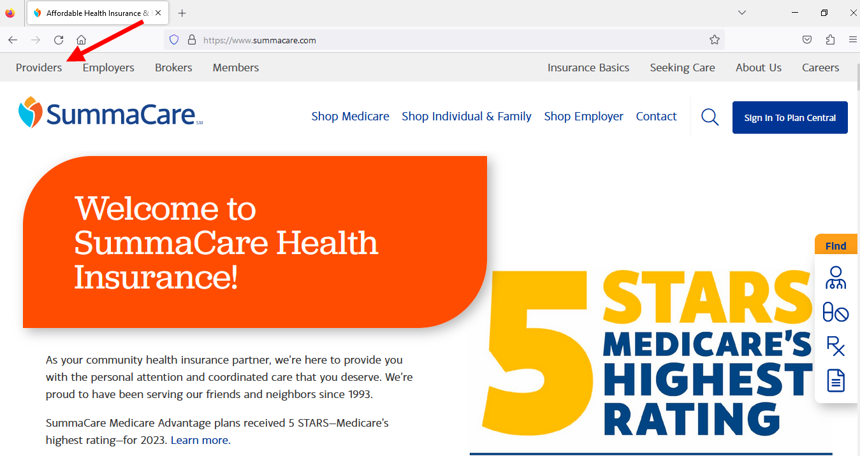
SummaCare Provider Portal www.summacare.com
You can find these and many other resources on website under the Providers Section. Please check back often for new information and updates.
Access to Plan Central
Become a Network Provider
BetterDoctor
EDI & HIPPA
Find a Network Provider
Health Services
Clinical Practice Guidelines
Quality Management
Provider Manual
Provider Policies
Pharmacy Management
Provider News
Provider Education
Vendors Serving SummaCare Providers

Slide 39
SummaCare Provider Portal Plan Central
Online access to review pertinent member, benefit and claim information:
Eligibility: allow providers to search up to 35 members at once
Family Summary: lists all family members enrolled on the plan
Coordination of Benefits Status: shows whether SummaCare is the primary or secondary payor
Benefits: view copay/coinsurance/deductible and additional plan details
Benefit Accumulators: see how much has been applied to the deductible or out of pocket
Claim Status/History: review the status of claims that were submitted by your office
Claim Entry: the ability to submit a claim
EOP Access: ability to print your Explanation of Payments (EOP)
Authorization Inquiry: view the status of authorizations for your office
Online Authorization Request: capabilities for all services
Prior Authorization Code Look Up: look up CPT/HCPC codes to determine if prior authorization is required
CES – Claim Editing Software: CES will provide you with the logic for code edits
Benefit Balances: determine whether a member has used a specific benefit (e.g. vision exam, chiropractic visits, PT/OT)
Additional Functions are available

Slide 40
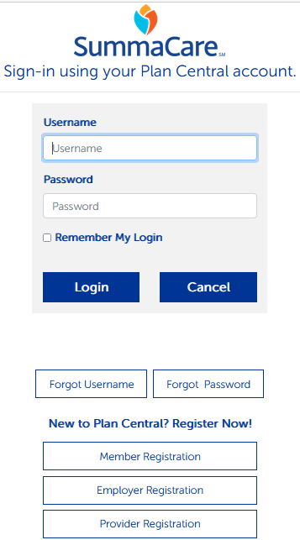
SummaCare Provider Portal Plan Central
To create a Plan Central account click below.
Plan Central Access

Slide 41
If you have questions, please contact your Provider Engagement Specialist: providerengagement@summacare.com 800.996.8401 Thank you!

